Slide 1
VISION BASED INDOOR NAVIGATION SYSTEM USING EXTERNAL CAMERA MOUNTED ON ROOM
G.S.U. Ahmadh, I.I.S. Premasri, A.N.F.M. Begum and M.F.M. Abdul Cader
Department of Electrical and Telecommunication Engineering, South Eastern University of Sri Lanka, Sri Lanka
AND Dr. W.G.C.W. Kumara Ph.D
Department of Computer Science & Engineering, South Eastern University of Sri Lanka, Sri Lanka

Slide 2
contents
What is this research about? – An introduction
Existing solutions and what are the issues with them – The motive for the research
How our system improves the indoor navigation
Conclusion and Future works

Slide 3
What is it about?
It is vital to have a very good path planning for self-navigating mobile robots.
Having considerations of the environment and objects in the space is a key in achieving a safe and effective path for robots.
In indoor environments, objects and the environment are unpredictable, unlike that of in the road navigation where there are standard guidelines and road symbols.

Slide 4
What is it about?
Indoor positioning systems based on Infrared, Wi-Fi and other similar techniques are existing in the industry.
Also, there are solutions providing such systems with the use of camera on the robot.
Although such systems deliver the positioning of the robot and thus generating a path based on it, they fail to have an overall view of the entire space so that the generation of the path is less efficient.

Slide 5
What is it about?
To overcome this,
Our solution provides an overview of the entire configuration space and generate the path based on it.
Eliminates the issues of path blocks and thus the need of re-navigation

Slide 6
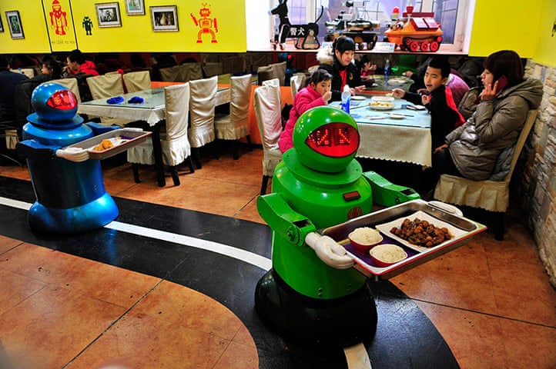
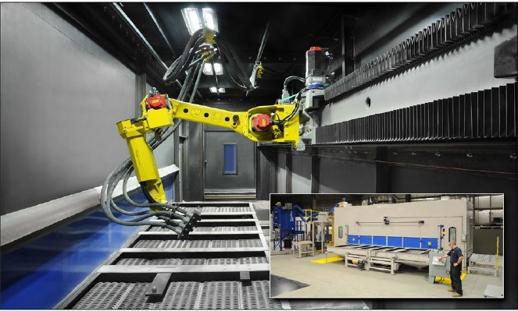
Existing autonomous indoor navigation Solutions
Fixed-Path following solutions
Line following robots
Rail tracked robots

Slide 7
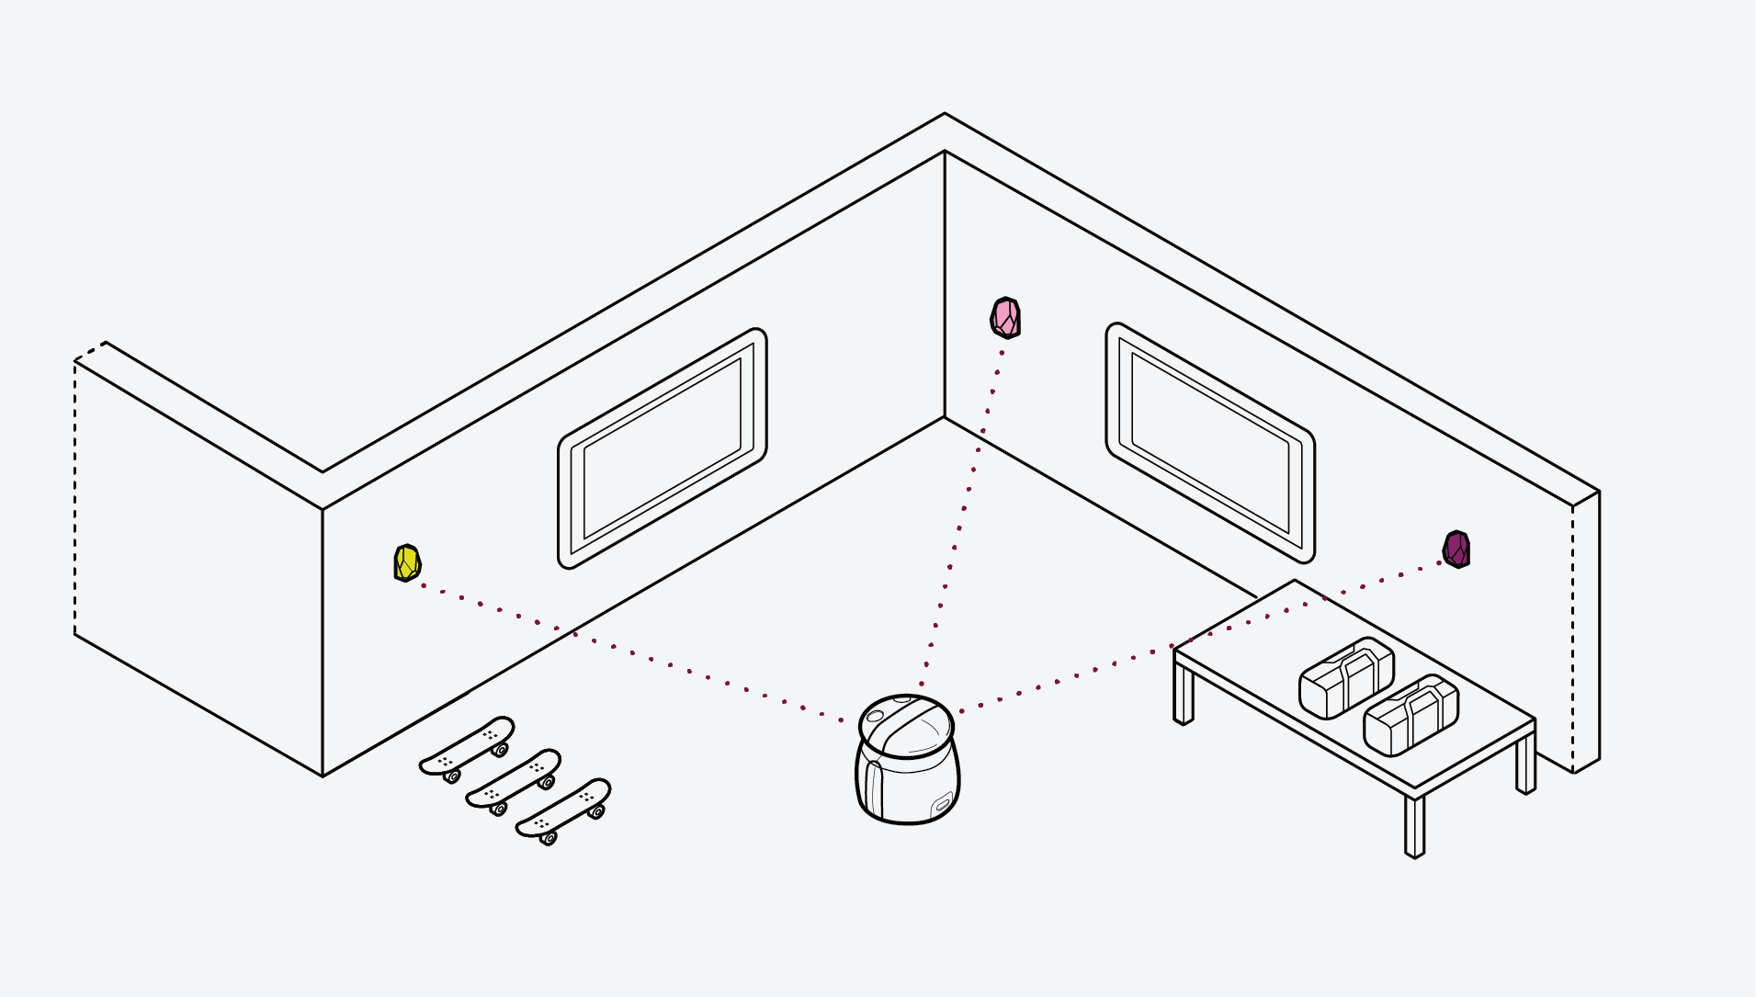
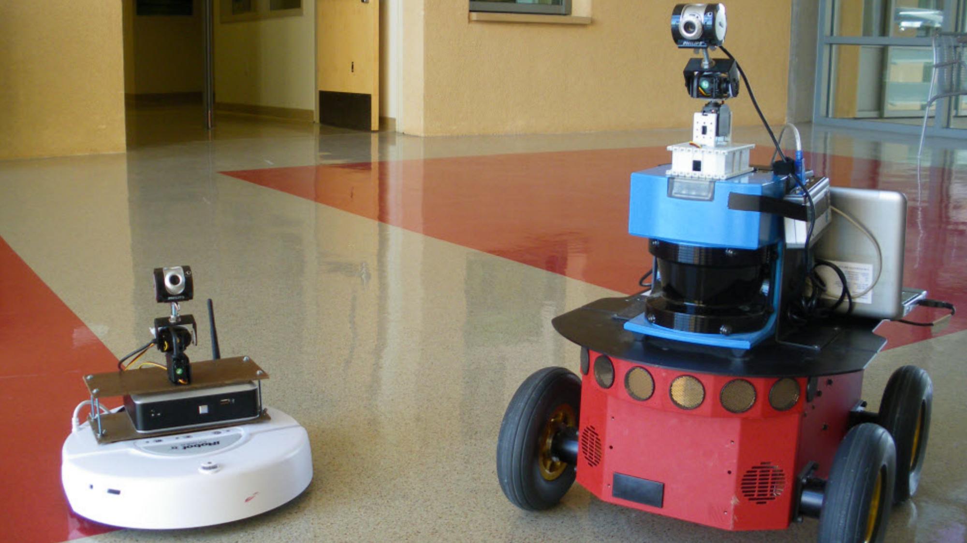
Existing autonomous indoor navigation Solutions
2. Dynamic-Path following solutions
Sensor based navigation
In-build camera based visual navigation

Slide 8
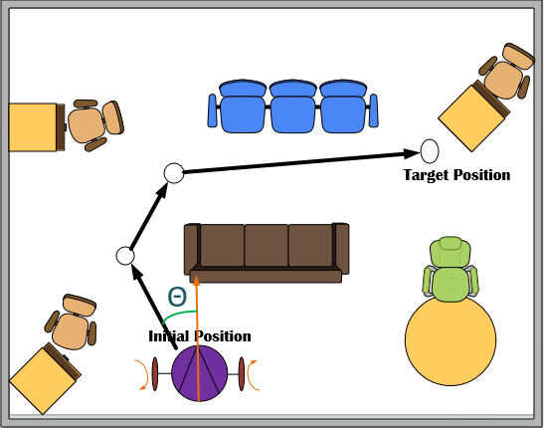
Proposed methodology
Generation of map and planning with the use of in-built camera on the ceiling of the room take an overview of the room and the objects present in the room.

Slide 9
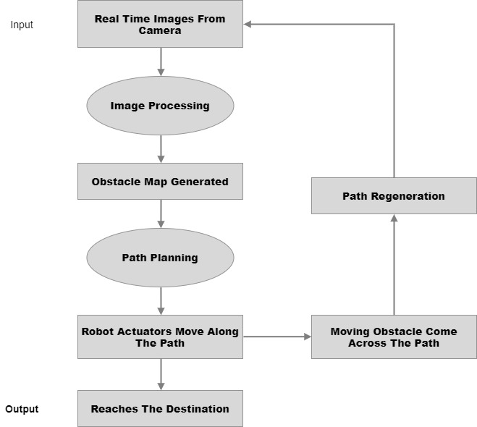
Proposed methodology

Slide 10
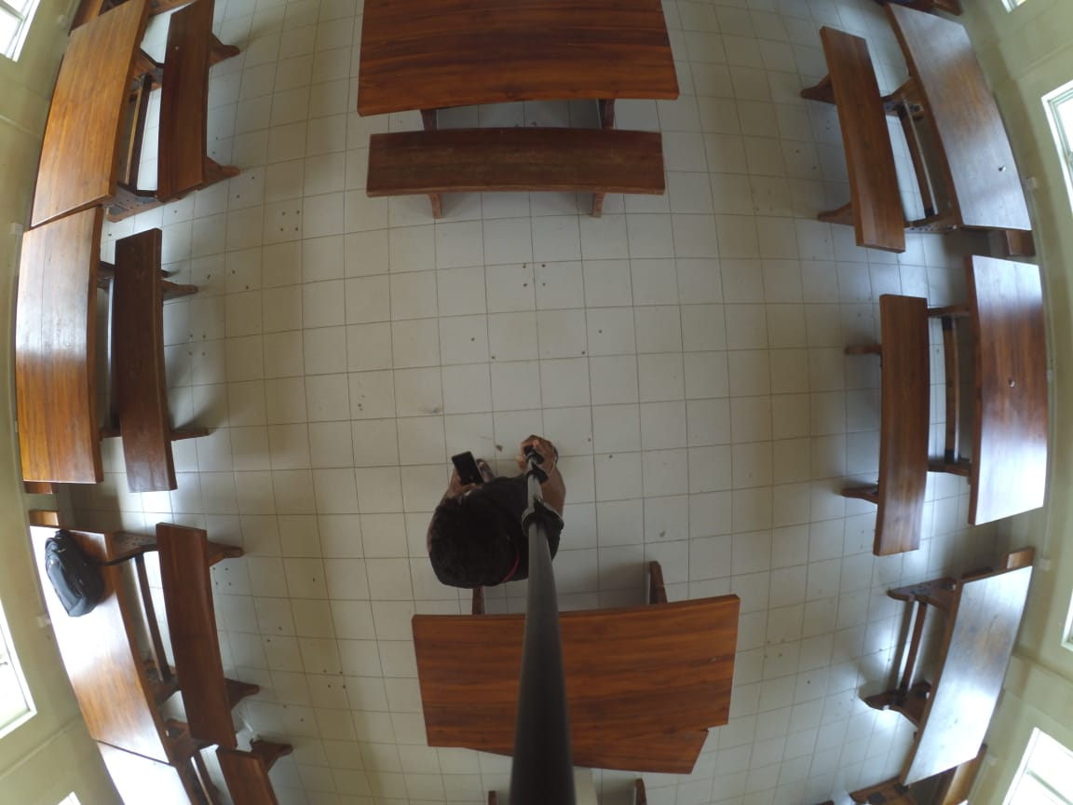
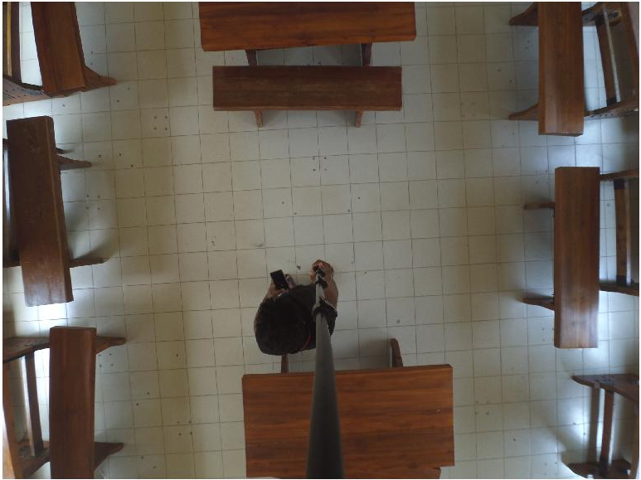
Proposed methodology
1. Capturing and processing the images of the room with cameras mounted on the top of the room

Slide 11
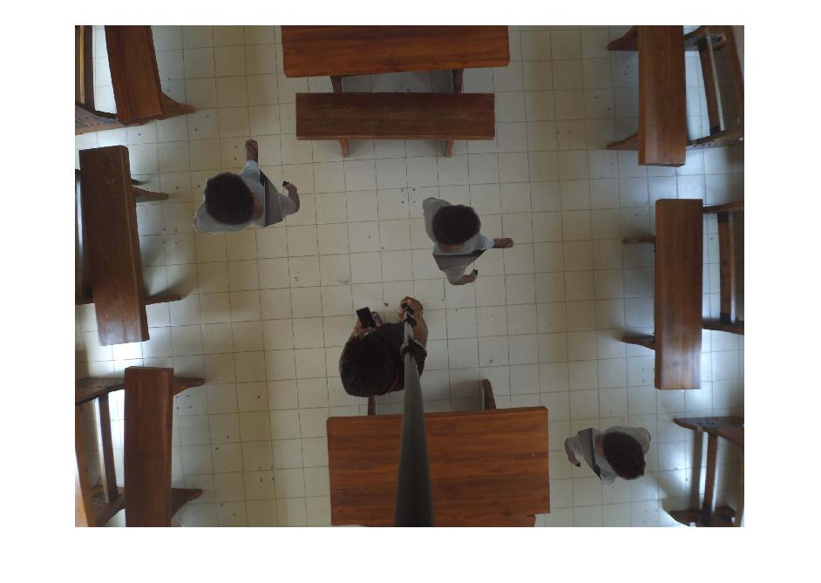
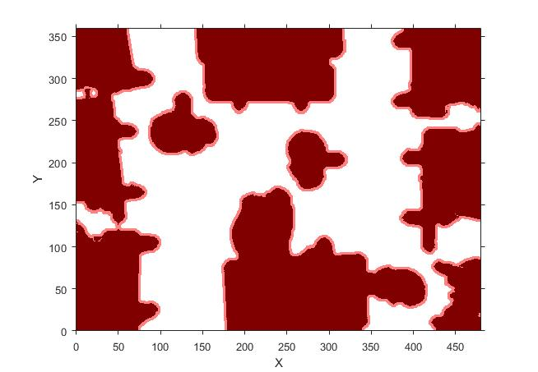
Proposed methodology
2. Detection of objects in the room and classifying of moveable paths and obstacles,

Slide 12
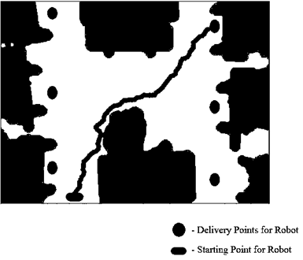
Proposed methodology
3. Generating the path for the robot to its destination using the RRT* algorithm

Slide 13
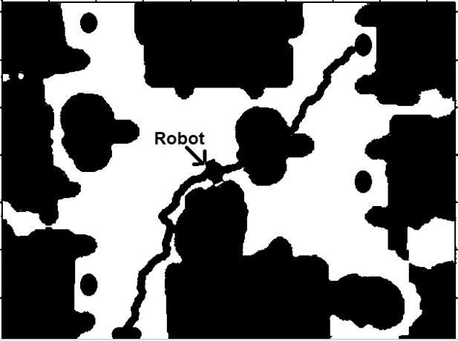
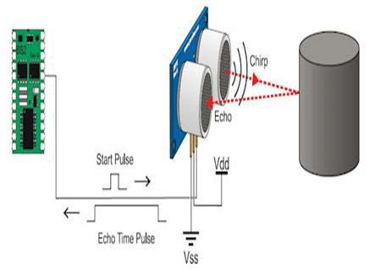
Proposed methodology
4. Suddenly encountering an object

Slide 14

Proposed methodology
5. Regeneration of path when a new obstacle is introduced in the previous path

Slide 15
conclusion
The most of the indoor service robots are using a fixed path and some other methods use sensors built in the robot to navigate to navigate in the environment.
Not efficient as they do not consider the entire configuration space when path planning.
An external camera based navigation system will be a solution with overall view of the room.
With that, an obstacle map of the room and the path for the robot to are generated
Added advantage over other existing systems in the industry:
provides solution for sudden objects that come across the path by allowing the robot to re-request a new path after a waiting time allowing to check whether the object is moving away from the path.

Slide 16
Future works
In future, authors plan to improve this with optimizing the path and to include prediction of moving obstacles and improving the efficiency in indoor path planning process with the help of Artificial Intelligence and Computer Vision

Slide 17
Thank You

